Slide 1

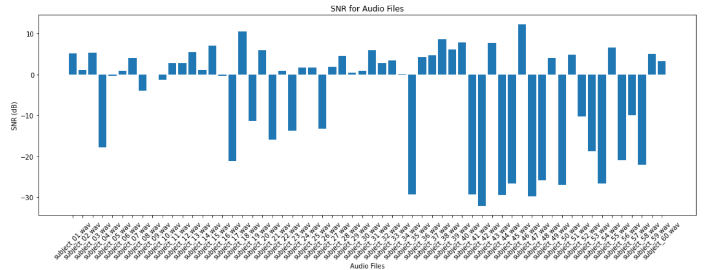
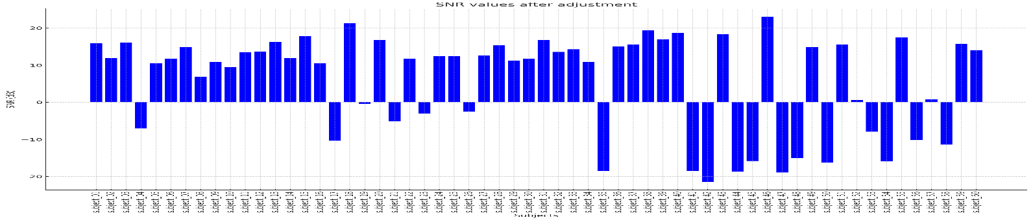
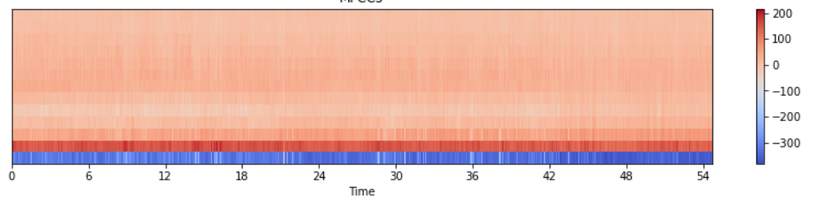
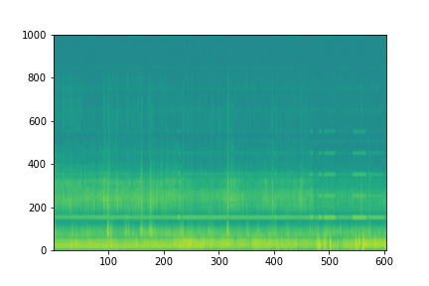
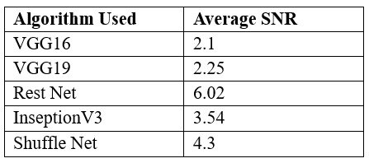
Denoising Fetal Heartrate Phonocardiography Using Machine Learning
Srujan Eppalapally – MS. Data Science
Mentor: Dr. Christelle Scharff
Pace University, Seidenberg School of CSIS
Logo
ABSTRACT
Accurate monitoring of fetal heart rate (FHR) is essential for assessing fetal well-being during pregnancy and labour. However, there is an important challenge: FHR sound recordings include noise. Current solutions tend to discount memory simplicity and real-time processing in favour of traditional signal processing techniques. Our study addresses this gap by introducing a novel method of converting sound files(.wav) into spectrograms and using deep learning techniques to reduce noise. Our goal is to maximize memory utilization while maintaining clinical accuracy, providing a workable way to enhance fetal health monitoring in medical environments.
RESEARCH QUESTIONS
What is the most efficient approach for memory optimisation when converting .wav audio recordings?
What combination of deep learning techniques can be harnessed for efficient and memory-conscious denoising of fetal heart rate?
How can transfer learning from pre-trained models in machine learning help in the creation of efficient denoising?
DATASET
The fetal phonocardiography (fPCG) dataset held by IIScFHSDB is made up of recordings of fetal heart sounds that were taken from expectant women. Using an electronic stethoscope, the recordings are made at St. John's Hospital in Bangalore.
Data Collection Context:
Demographic Information: The age of mother ranges between 18-27 years of age with gestation weeks between 30-40.
Clinical Setting: Biopac Student Lab software is used to capture the data, which is subsequently produced as an audio file (.wav) that may be read in MATLAB for additional analysis.
Recording Equipment: (fPCG) recordings made with electronic stethoscopes (SS30LA) connected to a data acquisition system (MP36, Biopac Systems Inc.) in labour wards by placing the electronic stethoscope on the lower abdomen of the subject(mothers) with a gain of 500X and a sampling frequency 2 kHz.
Environmental and Noise Factors: Because of congestion and a lack of private wards, the level of external noise is far greater.
METHODOLOGY
preprocessing of raw .wav files, including data loading, exploration, and visualization to gain insights into the FHR recordings
To measure the noise in the audio we use SNR, SNR quantifies the ratio of the power of the signal to the power of the noise present in the signal. SNR provided a reliable measure of the improvement in signal quality, with higher SNR values indicating superior denoising performance.
SNR=10⋅log 10(power of the signal/ power of the noise in the signal)
A heartbeat sound should ideally be audible at an SNR ratio of 10 to 20, however in the interest of conservation, we measure SNR ratios between 5 and 15.
Spectrograms were generated from the preprocessed .wav files to convert the time-domain audio signals into the time-frequency domain. Various spectrogram parameters, such as window size and overlap, were fine-tuned for optimal representation(Fig 1)
First filter to denoise using wavelet filter and median filter to see any significant changes in the noise.
pre-trained models were applied to the spectrogram images to remove noise and enhance the signal quality
Signal-to-noise ratio (SNR) was employed as the sole evaluation metric.
RESULTS
Fig1
In above both spectrograms(belong to same audio file) we can see that above is before applying the ML models above spectrogram is with SNR of -17.81 after denoising specific audio wave has been improved to 3.4 (rounded)
Below Table lists the algorithms used and the average SNRs for corresponding algorithm
We can see that restNet algorithm has performed better in denoising the audio wave.
CONCLUSION
By utilizing pre-trained deep learning models, we were able to denoize the heartbeat audio and successfully enhance the quality of the FHR spectrogram data, with an average SNR score of 6.02. Our approach highlights how deep learning may be used to improve fetal health monitoring. I would say this is the best results that I have reached in my analysis but there would be always space for improvement with proper medical knowledge background and guidence
FUTURE WORK
Future works need to concentrate on creating real-time denoising algorithms that aid medical professionals in real-time fetal monitoring sessions by offering prompt information into the health of the fetus. Examine how flexible denoising models are in order to manage variable noise levels in clinical recordings and ensure reliable performance in a variety of scenarios. Expand the study to include quantitative analysis of FHR patterns in addition to noise reduction. To give a more thorough evaluation of denoising performance, think about include evaluation criteria other than SNR.
BIBLIOGRAPHY
https://dolby.io/blog/beginners-guide-to-visualizing-audio-as-a-spectogram-in-python/
https://www.sciencedirect.com/science/article/pii/S266699002200026X
https://www.sciencedirect.com/science/article/pii/S1746809421010545
https://www.sciencedirect.com/science/article/abs/pii/S1746809422005407
https://www.sciencedirect.com/science/article/abs/pii/S0169260720314371
https://www.sciencedirect.com/science/article/abs/pii/S1746809420302895

